Slide 1
Open-Source Climate (OS-C) Overview Tapping the Massive Power of Open Source to Build a Public Utility of Data and Analytics
April 2023

Slide 2











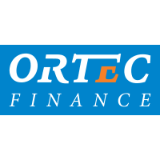











Members & Partners
PREMIUM MEMBERS
GENERAL MEMBERS
ASSOCIATE MEMBERS
PARTNERS & DATA PROVIDERS
World Resources Institute

Slide 3
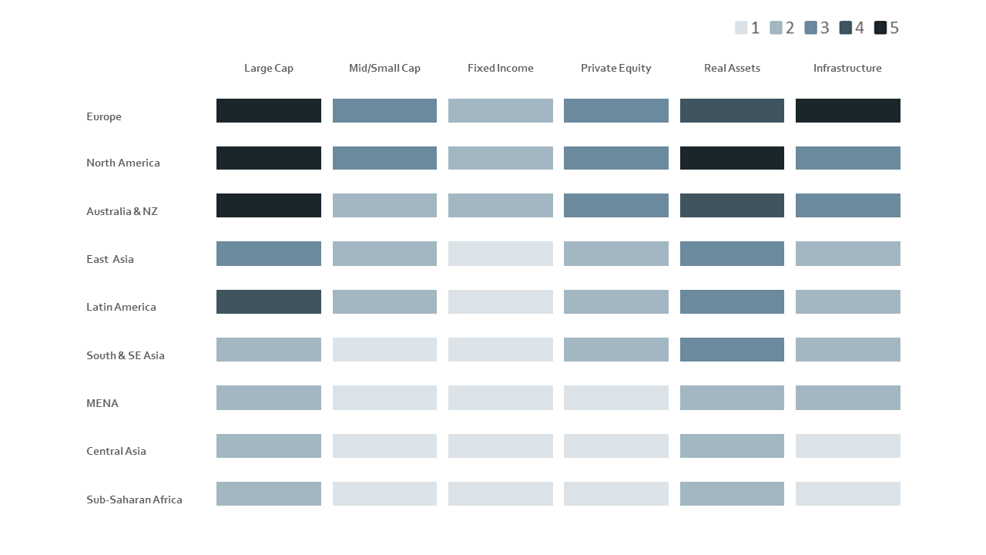
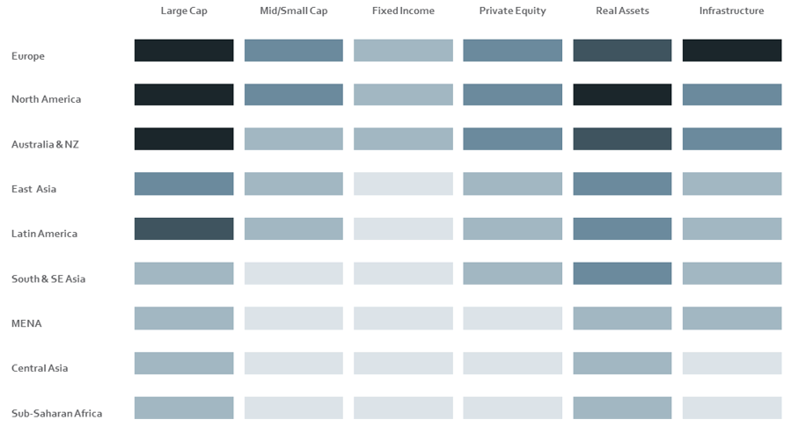
Problem: investors lack data coverage, quality, interoperability required for scaling climate impact
Well covered
Less covered
Data and existing tools’ coverage of asset classes beyond listed large-cap equities is poor
1
Situation in countries outside OECD even worse
2
Quality, comparability, interoperability, and trust are often poor
3
3

Slide 4






OS-C proposes concrete measures to address climate risks and opportunities
Problem
Specific issues
Actions
Gap of $5+ trillion annually to achieve Paris Climate Accord goals
1
Investors
Build holistic data and analytics solution essential to meet Paris Goals
Companies
Until government regulation / incentives enter into force, most corporations will not transition fast enough on their own
Overexposed to Climate Risks / Underexposed to Climate Solutions
Accelerated large scale capital reallocation by financial institutions is needed
2
Build Co-op to leverage many stakeholders‘ intellectual property, know-how, and effort
GFANZ, corporates, NGOs, and the public urgently need trustworthy data and transparent analytic tools to drive change
Society
Governments
4

Slide 5
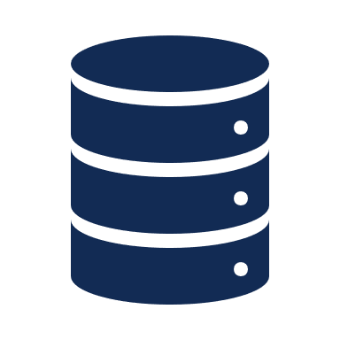











Solution: OS-C is uniquely able to breakthrough by...
building a world-class shared platform …
through community collaboration …
that is truly open source!*
Employs cutting edge technology architecture, IT backbone, and “data as code” approaches
Linux Foundation governance structure and licensing enable sharing of effort, cost, and intellectual property.
Builds trust through publicly transparent governance, open meetings, open dialogue
A “public utility” of data and tools that can interact easily with private data and tools
Data as code, accurate data provenance, interoperability
Translates science & evolving accounting standards and metho-dologies into code
Combines know-how and aligns interests among stakeholders –regulators, investors, banks, NGOs, academia
More accurate and forward-looking climate and ESG metrics as public good
* Note: not “Openwashed” – most initiatives in the ESG finance space claiming to be “open source” are at best “open code” or “open access” which lack the transparency and open collaboration characteristics essential for trust, and they impede public benefit with licensing restrictions to capture revenue.
5

Slide 6







OS-C operating model leverages open source principles
COMMUNITY INPUT
PLATFORM based on
Red Hat‘s Operate First
SHARED ADVANTAGES
Business leaders set goals
“Trust open communities with running and managing applications and infrastructure”
Maximal reliability and transparency
Data providers offer data and determine access
OPEN DATA SCIENCE PLATFORM
Increased scalability
Develop and deploy models and tools
Interfaces
Data commons data types
Tools
Public record of all con-figurations and community discussions
Data sources
Data commons
functionality
Monitoring and Management incl. review and audit before making updates
Total open source visibility and participation in the configuration and deployment managed by OS-Climate
Share costs, intellectual property, and effort
6

Slide 7
OS-C: 3 main building blocks for a game-changing solution
OPEN SOURCE COMMUNITY
GLOBAL DATA COMMONS
ANALYTICAL TOOLS
Physical Risk & Resilience
Transition Scenario Analysis
Investment Alignment with Climate Goals
Data & Analytics Provider
High
Emitting
Industries
Climate factor data
Academia
Think Tank,
NGOs
OS Climate
Platform
Platform Infrastructure
Asset
Managers
Banks
Company data
Asset Owners
IT Compa-nies
7

Slide 8
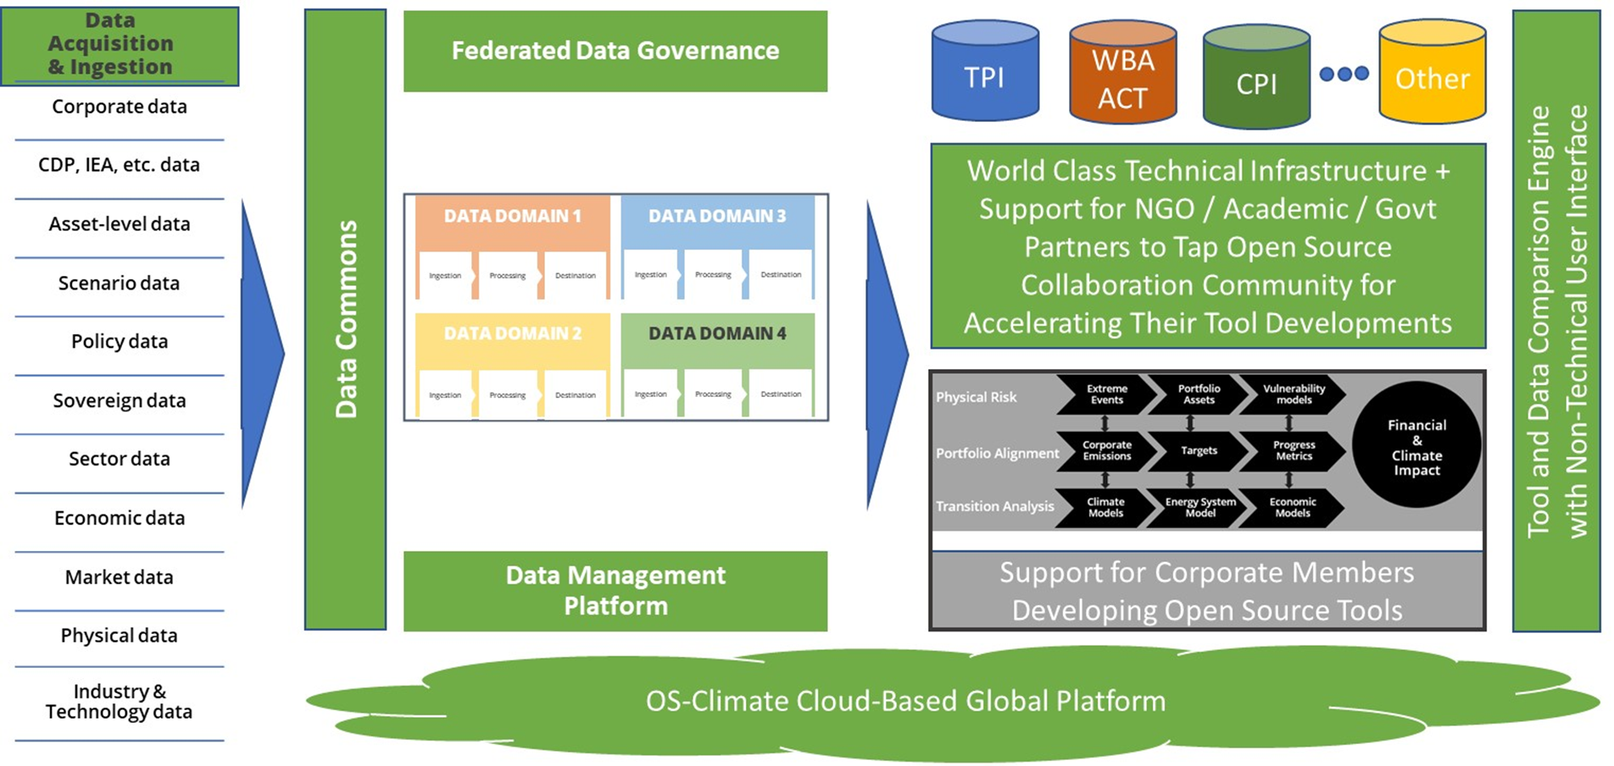
Data & Analytics Public Utility >> Global Impact
USERS INCLUDE
The Public
Net Zero Alliance Members
Counter-parties
CA100+ and other Corporates
Policymakers & Regulators
NGOs, Scholars, Researchers
IMPACT: Closing the Data Gap >> faster financial institution exit from laggards and reallocation into leaders + more effective investor and public engagement + clearer risk and incentive pricing >>> informs corporate strategy and planning >>> drives investment in resilience and Net Zero >>> Accelerated reduction of Gigatons CO2E

Slide 9
OS-C’s Public v. Private Benefit
Measure ROI by accelerated emissions reductions & resilience investment
Measure ROI by speed and scale of net-zero aligned decisions and projected GHG mitigation & resilience impacts
Private Partnership
Public Good
Joint Benefit
Free, easy-to-use point of access to public data required for climate-aligned finance + advocacy.
Federation services, connecting wide range of academic, Govt, NGO sources to financial decisionmaking.
High Trust – independent scientific review as part of governance.
Tools built by private sector independently but verified as science based & free for public uses (e.g., engagement, policy).
Open collaboration space uniquely able to help the climate-finance community speed up convergence on, and implementation of, methods and standards.
Transparently developed comprehensive roadmaps + model methodologies.
Tools designed for institutional requirements for meeting Net Zero finance. Investment, and risk management (physical, transition, alignment, etc).
Ability to leverage Data Commons with proprietary and licensed data Technical FTEs committed by members to jointly build solutions.
Serve small-to-medium sized orgs & Global South
9
Theory of Change
Open Source Collaboration/Innovation
Data Commons Architecture
High-Integrity Governance with Independent Academic and Scientific Advisory
Linux Foundation Credibility

Slide 10
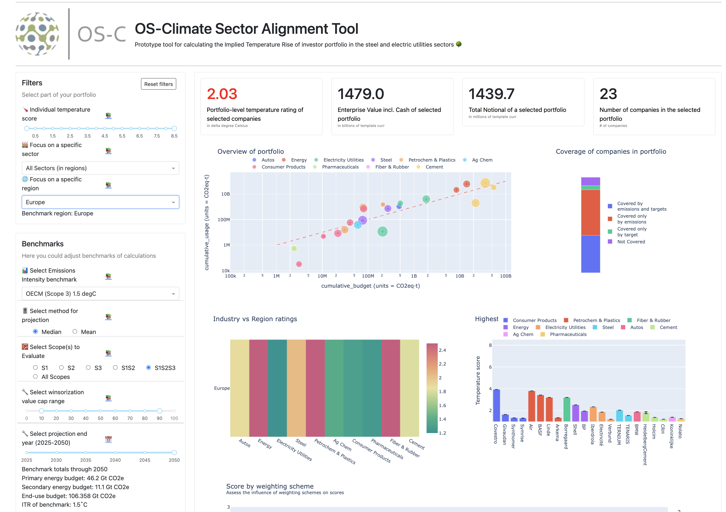






Sector Alignment Tool (SAT) -- Allianz Lead
Enable climate-aligned portfolio construction, securities selection, corporate engagement, etc.
SAT Tool generates portfolio level scores across different climate scenarios, sectors and regions
Tailored analytics for selected corporates across:
Sectors (defined in benchmarks)
Regions (defined by user data,
mapped to benchmarks)
Scopes (S1, S1+S2, S1+S2+S3, etc.)
Time horizon 2025-2050
Aggregation types (e.g. weighted average, enterprise value weighted etc.)
Scenarios (e.g. OECM, TPI)
10

Slide 11
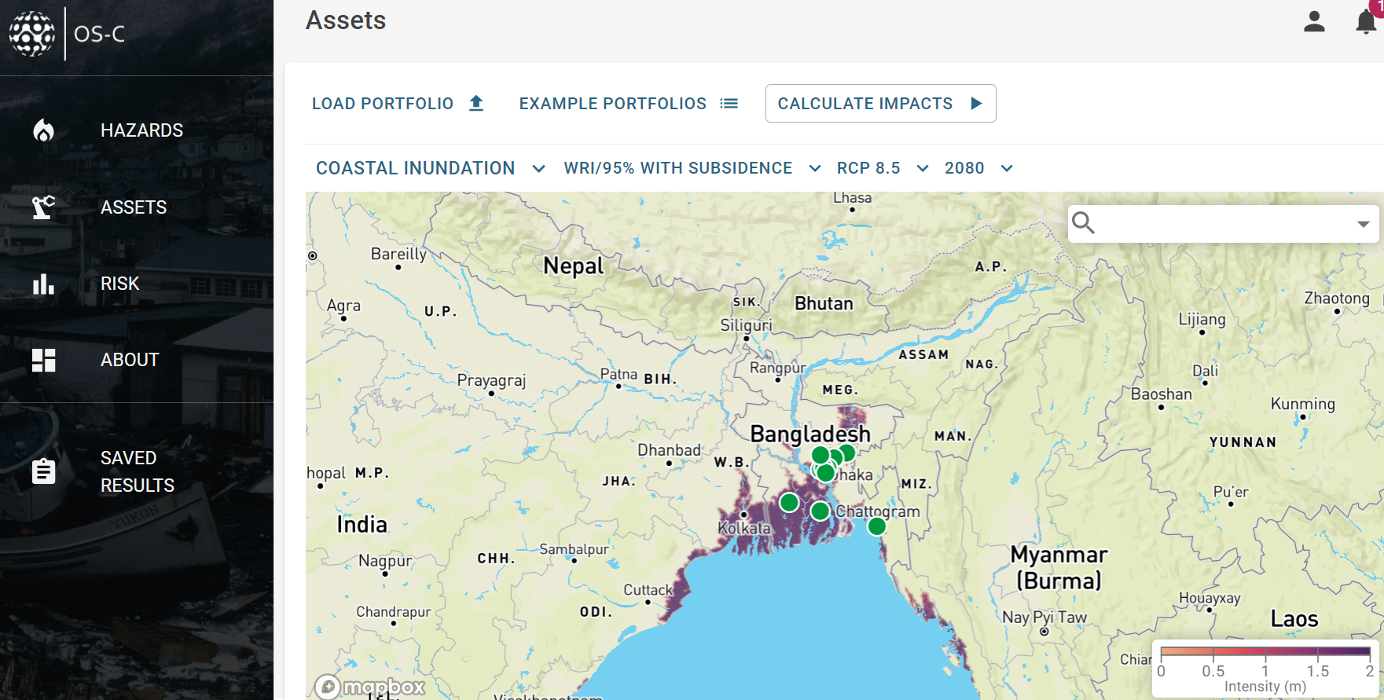
Physical Risk & Resilience (PRR) -- BNP Paribas Lead
Innovation through collaboration: range of potential use cases
Enhancing knowledge within organizations
Operational Risk
Origination of loans & investments
Portfolio risk measurement
Disclosures
Resilience & adaptation measurement & finance
Public benefit uses such as assessing risk & resilience opportunities for communities, infrastructure, crops, etc.
11

Slide 12
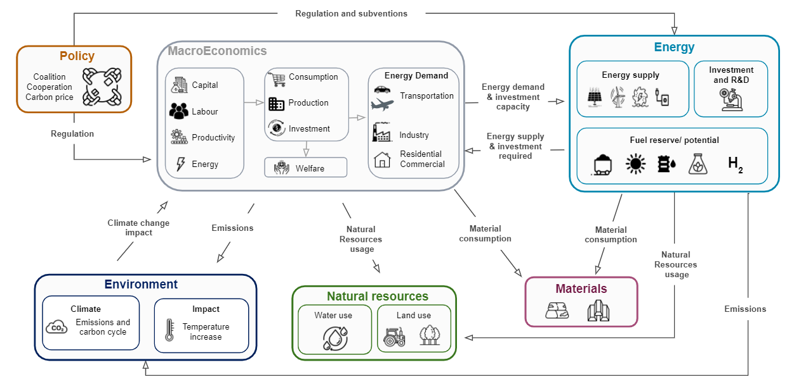
Transition Analysis Modeling Platform -- CapGemini Lead
Explore sustainable transition scenarios to enable transition-aligned strategy & investment decisions for corporates, financial sector, & governmental / intergovernmental agencies
Energy model take into account regulations and subventions
Energy model fully coupled with macro-economic model in both directions
Energy model including production technologies mix allow to take into account specific materials resources usage limitation
Energy model including production technologies mix allow to take into account accurately natural resources usage limitation
Energy model including production technologies mix allow to take into account accurately energy production emission
Macro-economic model take into account natural resources usage limitation
12

Slide 13
APPENDIX

Slide 14
OS-C is platform of interconnected components and workstreams
Portfolio Alignment,
Physical Risk & Transition Analysis
Interfaces
Extreme Events
Vulnerability models
Portfolio Assets
Financial & Climate Impact
Infrastructure
Corporate Emissions
Targets
Progress Metrics
Climate Models
Energy System Model
Economic Models
Platform & Tooling
Data commons
functionality
Data availability (hazard, asset, financial)
Data security, quality & accuracy
Data comparability
Data exports
Data Management Platform
Data commons data types (e.g. counter-party/ corporates)
Entity Matching
Assets
Emissions, Targets, Progress
Other
Data Science & Analytics Platform
Data sources (Public/Proprietary/Metadata): Federated, Uploaded, & Derived
14

Slide 15
Governance structure and business model
SERIES LLC
SERIES LLC
SERIES LLC
SERIES LLC
GOVERNING BOARD
TECHNICAL ADVISORY
COUNCIL
Data Commons
Technical Steering Committee
Portfolio Analysis
Technical Steering Committee
Physical Risk & Resilience
Technical Steering Committee
Transition Analysis
Technical Steering Committee
OUTREACH
LEGAL
BUDGET
DEV & DATA
COMMUNITY
DEV & DATA
COMMUNITY
DEV & DATA COMMUNITY
DEV & DATA
COMMUNITY
Business model: non-profit 501(c)(6) business association under the Linux Foundation (largest organizer of open-source tech initiatives globally); platform management and development funded by annual member fees plus philanthropic grants.
Governing Board (fee-paying members + Academia, IGO, NGO) decides strategy, priorities, & budget.
Premier Membership: $100K/year; General Membership $30K/year; Associate Membership (Academia, IGO, NGO): $0K/year
Meets every 3rd Wednesday of the month
Technical Advisory Council (TAC) sets technical vision, facilitates collaboration among the Technical Projects, and recommends budget and technical decisions to Board.
Comprised of TSC chairpersons and Premier Members’ technical delegates.
Meets 2nd and 4th Monday of the month
Technical Steering Committees (TSCs) is responsible for technical oversight of each Project.
Data Commons Charter: https://docs.google.com/document/d/1yLL3fBkwe_EC1EOtBHV7mAThlDVSA5dQnkI4Ijnv0eI/edit?usp=sharing
Physical Risk & Resilience Charter: https://docs.google.com/document/d/1TiHw4KL2sQIdUsvkKq0Eg-ju5T681nQC/edit?usp=sharing&ouid=111309013911865667965&rtpof=true&sd=true
Portfolio Alignment Charter: https://docs.google.com/document/d/1l5Sdz0YODYA8uLO4NHMykYLtOsUHl5nK/edit?usp=sharing&ouid=111309013911865667965&rtpof=true&sd=true
Transition Analysis Charter: https://docs.google.com/document/d/1oApdAxwjM8_TCeHFgBE8GJp-JOeM6U21/edit?usp=sharing&ouid=111309013911865667965&rtpof=true&sd=true
10
15

Slide 16
OS-C Org Chart
Physical Risk & Resilience
Data Mesh
Data Exchange
Entity Matching
Technical Advisory Committee
Governing Board
Portfolio Alignment
Transition Scenario & Risk Analysis
Research & Academic Council
Core Team
Linux Foundation Services
Finance
Marketing
Website
Community Management
Community Leadership & Strategy
DevOps & Release Engineering
Community Coordination
Product Management
Technical Program Management
Data Extraction
Data Commons
Research & Academic Oversight
16

Slide 17
OS-C Org Chart -- Personnel
Michael Tiemann (Project Lead)
Heather Ackenhusen (Principal Technical Program Manager)
Workstreams
Stephanie Daley (EA)
Truman Semans (CEO)
Physical Risk
Data Commons
Data Extraction
Developers
Entity Matching
Even Hugues
(BNPP)
Technical Advisory Committee
Governing Board
Vincent Caldeira Chair
(Red Hat)
Abhishek Narang (Goldman Sachs)
Portfolio Alignment
Transition Scenario & Risk Analysis
Community Management
Lead: Matt Sandoe (BNPP)
Lead: Leyla Javadova (Allianz)
Lead: Thierry Chevalier (Capgemini)
Leads: Thomas Kirchherr (IDS) and Vincent Caldeira (Red Hat)
Lead: Lea Deleris (BNPP)
Lead: Rui Dias Morais (BNPP)
Lead: Erik Erlandson (Red Hat)
Matthieu Meaux
(Capgemini)
Rui Dias Morais (BNPP)
Core Team
Richard Harmon (Red Hat)
Lisa Eichler
(Ortec Finance)
Tim Whitehead (Goldman Sachs)
Udo Riese Chair
(Allianz)
Truman Semans
(LF/OS-Climate)
107 team members
84 team members
45 team members
89 team members
79 team members
34 team members
96 team members
14 team members
Emily Ruf
(Event Mgr)
Ryan Aslett
(Systems Eng)
Eric Ball
(Release Eng)
Vincent Caldeira (Red Hat)
Brendan Reilly (Head of Corp Dev & AI)
Matt Sandoe
(Chief of Staff)
Alain Chardon (CapGemini)
Alain Chardon (Capgemini)
17

Slide 18
OS-C Members & Data Partners
Premier Members
BNP Paribas
Goldman Sachs
Red Hat
LSEG
S&P Global
Amazon
BNY Mellon
EY
Allianz
Ortec Finance
Polytechnique University
CPI (Climate Policy Initiative)
General Members
Associate Members
Data and Model Partners
Jupiter Intelligence
Urgentem
World Resources Institute
RMI
riskthinking.AI
The Net-Zero Asset Owner Alliance
Open Earth
World Benchmarking Alliance
CapGemini
Amundi
18

Slide 19
Research & Academic Council’s Role
An independent body whose governance role is set forth below and in the applicable charter for each Technical Project.
Ensures that OS-Climate’s data and tools continue to be science-based and to meet the highest standards of scholarship in the fields relevant for climate-aligned business and finance.
Reviews key modeling methodological choices and assumptions to ensure that these align with current, peer reviewed scientific studies and scholarship.
Helps Technical Projects identify and attract excellent scholars and experts to advise on, and contribute to, the Projects’ detailed development work on data and tools.
Advises the Governing Board on strategically important developments in the academic and research community, including relevant topics of debate, research projects, and initiatives.
Anchor member of RAC Selection Committee: Rosina Bierbaum, Chair of the Global Environment Facility Science and Technical Advisory Panel, https://www.moore.org/people-detail?personUrl=bierbaum-ph.d
19

